Slide 1
STP510A Week XI) Universities in national innovation systems David C. Mowery, Bhaven N. Sampat. 2012.
Euibeom Son
ubs5252@kaist.ac.kr

Slide 2
Contents
1. Introduction
2. Role of University in NIS
3. Effect of University Research
4. Policies for Technology Commercialization
5. Conclusion

Slide 3
Introduction
“The research university plays an important role as a source of fundamental knowledge and, occasionally, industrially relevant technology in modern knowledge-based economies.”
governments: (1970~)
creating “science parks” (nearby research university campuses)
support for “business incubators”, public “seed capital” funds
“bridging institutions”
Bayh-Dole Act (1980)

Slide 4
Context
1. Introduction
Industrial-economy national innovation systems:
the complex institutional landscapes that influence the creation, development, and dissemination of innovations
In “knowledge-based economy”, linking with industry can be the strategic assets
the rate of transfer of academic research advances to industry was increased
Tighter constraints on public funding (1970~)
some universities have become more aggressive and “entrepreneurial” in seeking new sources of funding

Slide 5
Role of University in NIS
Functions
"combine the functions of education and research“
Linear model (Vannevar Bush, Science: The Endless Frontier, 1945)
➔ U.S. universities = critical contributor to economic growth
= most appropriate institutional locus for basic research (public funding!)
However, there are cultural differences between academic research and industrial innovation. (these contrasts also can be overstated (David et al, 1999)
open and present first ⬄ secrecy & limitations to the disclosure

Slide 6
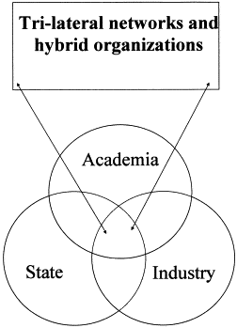
Frameworks & Limitations
2. Role of University in NIS
“Mode 2”(Gibbons et al., 1994)
more interdisciplinary, pluralistic, “networked” innovation system
purely academic research norms may prove less influential
“Triple Helix” (Etzkowitz and Leytesdorff, 1997)
In addition to linkages among institutional spheres,
each sphere takes the role of the other
⬅ “What is lacking in all of these frameworks, however, is a clear set of criteria by which to assess the strength of such linkages and a set of indicators to guide the collection of data.”

Slide 7
Cross-National Data
2. Role of University in NIS
first universities appeared during the Middle Ages:
autonomous, self-governing institutions, recognized by authorities.
universities in modern state:
belong to public university system, can be controlled by government
⬄
In the case of the United States, it was left to some degree to the autonomy of universities
Universities have become more ‘entrepreneurial’ with the needs of the era
High enrollment data (not in science and engineering)

Slide 8
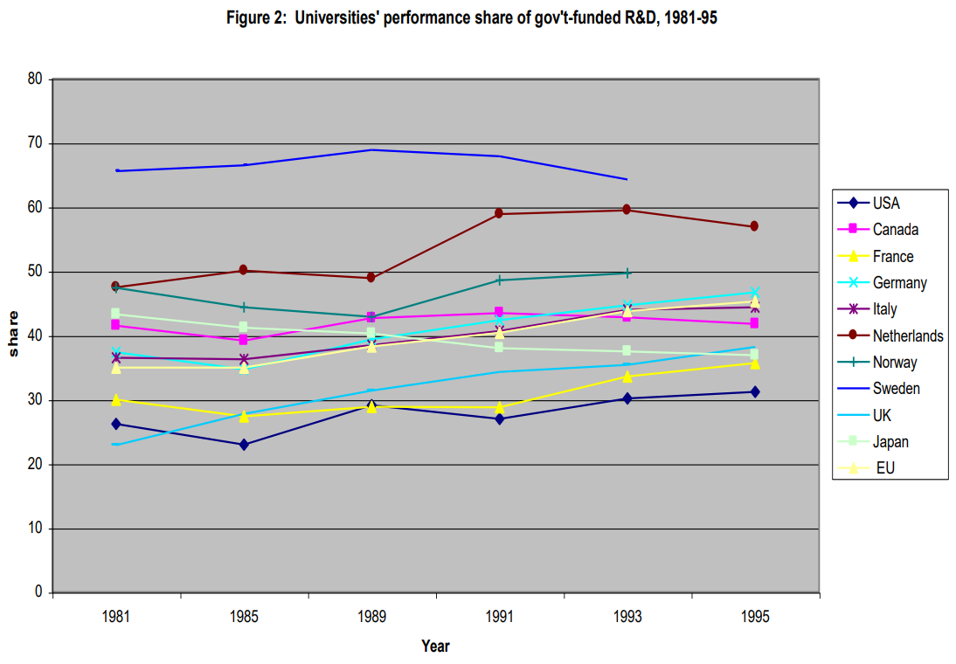
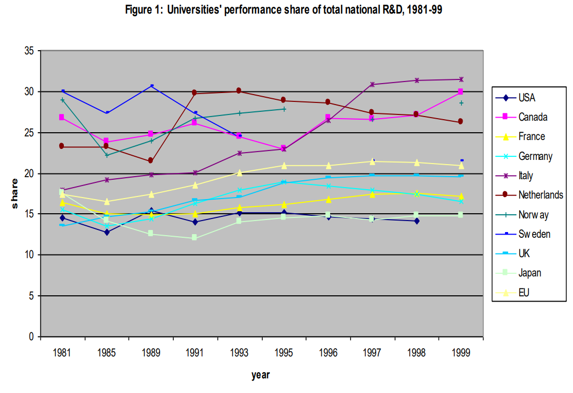

Slide 10
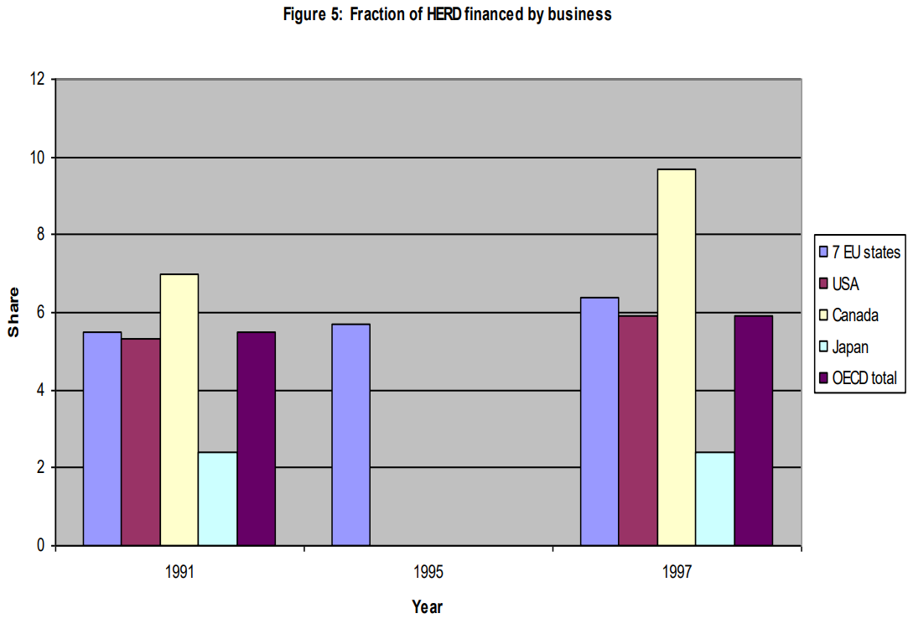

Slide 11
University-Industry Relationship
2. Role of University in NIS
From OECD 2002 study of “science-industry relationships” (2002, p. 37)
U.S. (higher than EU average):
“R&D consulting with firms by university researchers”
annual flow of university researchers to industrial employment
score about “significance of networks” linking universities and industry
* but the data on industrial support of academic research do not support U.S. characterization
* Even among OECD countries, functions vary according to major industries or historical processes, which makes hard to find emulation.

Slide 12
Recent Trends
2. Role of University in NIS
in university-industry linkages
U.K.
Calvert and Patel (2002) : threefold increase in co-authorship between UK industry and university researchers during 1981-2000
U.S.
Hicks and Hamilton (1999) : the number of U.S. papers coauthored by university and industry researchers more than doubled during 1981-1994
(in the total number of scientific papers : 38% increase)
(field) | computer science | chemistry | medicine | biology
(%) | > 800 | 120 | 120 | 114

Slide 13
Recent Trends
2. Role of University in NIS
Support for the "Mode 2" and "Triple Helix"
Lack of data and research
in university-industry linkages
U.K.
Calvert and Patel (2002) : threefold increase in co-authorship between UK industry and university researchers during 1981-2000
U.S.
Hicks and Hamilton (1999) : the number of U.S. papers coauthored by university and industry researchers more than doubled during 1981-1994
(in the total number of scientific papers : 38% increase)
(field) | computer science | chemistry | medicine | biology
(%) | > 800 | 120 | 120 | 114

Slide 14
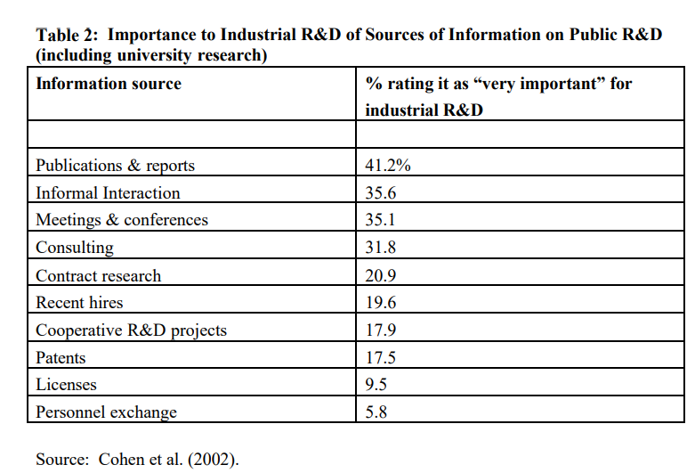
Effect of University Research
Several studies emphasize the significance of interindustry differences in the relationship between university and industrial innovation.
biomedical, pharmaceuticals: university research advances affect industrial innovation more significantly and directly

Slide 15
Policies for Technology Commercialization
case studies of two types of policies:
policies encouraging the formation of regional economic “clusters” and spin-offs based on university research
policies attempting to stimulate university patenting and licensing activities

Slide 16
Clusters
4. Policies for Technology Commercialization
policies encouraging the formation of regional economic “clusters” and spin-offs based on university research
e.g) Silicon Valley in California and Route 128 in the Boston area
knowledge spillovers in regional level
However, where is the evidence that universities 'cause' it?
The science park is not innovative. (Felsenstein (1994), Wallsten (2001))
The formal research links of park firms and off-park firms are similar to each other (Massey et al., 1992, p. 38)

Slide 17
Patenting and Licensing
4. Policies for Technology Commercialization
(2) policies attempting to stimulate university patenting and licensing activities
Bayh-Dole Act (1980)
It replaced a web of Institutional Patent Agreements (IPAs) that had been negotiated between individual universities and federal agencies with a uniform policy
The Act's provisions expressed Congressional support for the negotiation of exclusive licenses between universities and industrial firms for the results of federally funded research.
However…

Slide 18
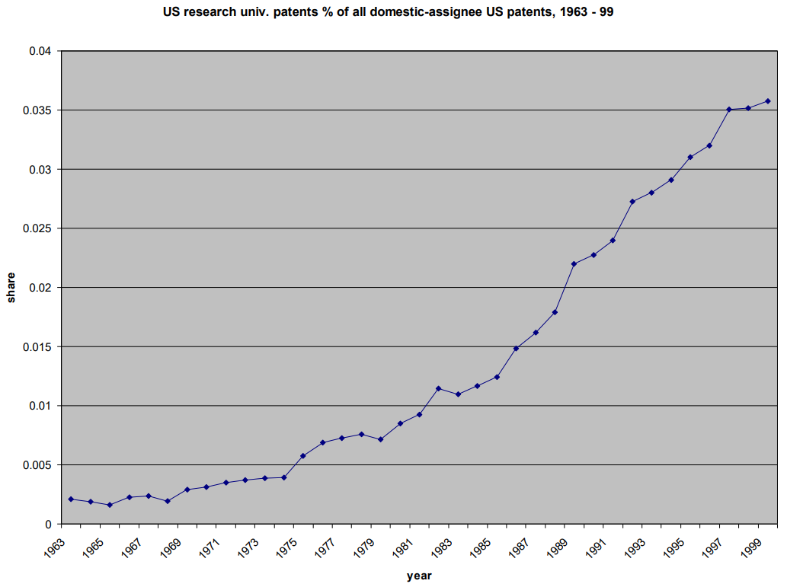

Slide 19
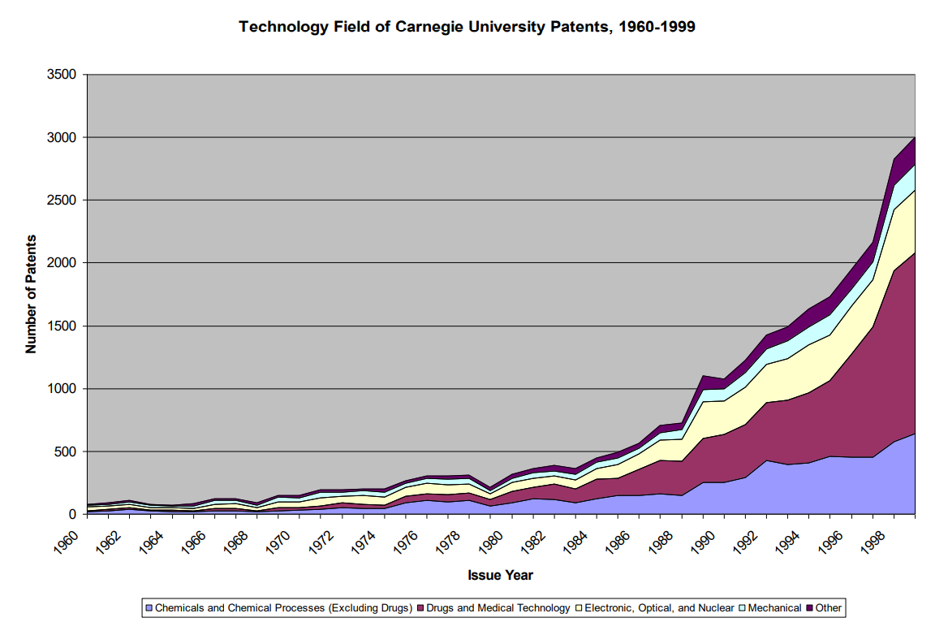

Slide 20
Conclusion
The reason why universities are difficult to be analyzed economically
1. Competition between universities is limited
2. Characterizing “the objectives of the university” is difficult
The "National Innovation System", "Mode 2" and "Triple Helix" models summarize and describe the role of universities well, but there is risk of emphasizing the means of production and makes it overwhelming the other aspects.

Slide 21
Conclusion
"absence of broader longitudinal and cross-nationally comparable indicators of university-industry interaction"
➔ We need better indicators! (e.g. firmlevel “absorptive capacity”)
“current emphasis on the countable rather than the important aspects of university-industry interactions could have unfortunate consequences for innovation policy in the industrial and industrializing world”
e.g. Bayh-Dole Act: may have weaken the “open science”, so that makes publication delays, secrecy, and withholding of data and materials (Dasgupta and David, 1994; Liebeskind 2001)

